Slide 1
ClimbCode
Notes:
Welcome to ClimbCode’s exposition. Here we’ll see the main features of this project.

Slide 2

Our Path Today
The Workgroup
Idea & MVP
Business and costs
Work Methodology
2
Notes:
The main points we’re going to talk about are the following ones: First, we’ll introduce the team which will develop the project. Next, we’ll talk about the idea that ClimCode represents and which are the features that form the Minimum Viable Product. Then, we’ll skip to the business environment and the costs of the project, followed by the ways that we will have in order to achieve profit with it. Finally, we’ll speak about the work methodology that will be followed in the development of the project, and the technologies that we will use on it.

Slide 3
The Workgroup
Notes:
First, let’s introduce our team members.

Slide 4


The Workgroup
Alejandro Román Rodríguez
Project Manager
Álvaro Domínguez Núñez Business Manager
4
Notes:
Alejandro Román, who is the Project Manager, Álvaro Domínguez, the Business Manager…

Slide 5


The Workgroup
Andrés Fernández Alés
Software Engineer
Alejandro Garrido Resina
Software Engineer
5
Notes:
And the software Engineers: Andrés Fernández, Alejandro Garrido…

Slide 6


The Workgroup
Miguel Ángel Baños Carretón Software Engineer
Álvaro Sánchez López
Software Engineer
6
Notes:
Miguel Ángel Baños, Álvaro Sánchez…

Slide 7
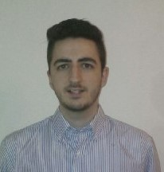
The Workgroup
Jesús Sosa Sánchez
Software Engineer
7
Notes:
And Jesús Sosa. These are our seven members.

Slide 8
Idea & MVP
Notes:
Now we’ll talk about the main idea of ClimbCode, and its principal features.

Slide 9

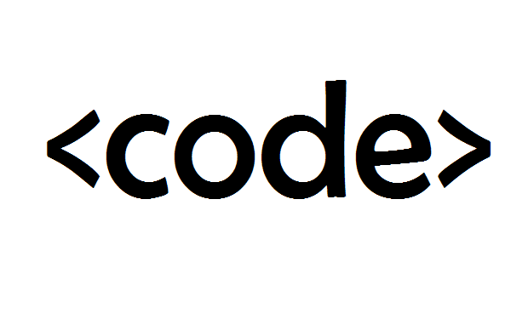
Idea & MVP
+
=
ClimbCode
9
Notes:
ClimbCode is the result of a fusion between teaching and programming. This fusion is, in fact, a plataform used to support the teaching of different subjects at high schools and academies. This support is given as interactive exercises made by programmers which use programming in order to teach other concepts from other different subjects.

Slide 10


Idea & MVP
=
+
Interactive
10
Notes:
This exercises are nothing but a combination of the usual exercises from other subjects and coding, which results into a new brand kind of exercises which form the principal content of our platform. These exercises are an alternative to the usuales ones instead of a way to learn programming, fulfilling the objectives of the usual ones in a new and interesting way.

Slide 11

Learn Programming?
11
Notes:
But the fact of using programming to create those exercises makes a great doubt appear: Is it necessary to learn programming to use this plataform as a school?

Slide 12

Learn Programming?
12
Notes:
The answer is absolutely not! And that’s because the exercises, despite being created by those means, are interactive and both teachers and students can make use of them without any programming knowledge.

Slide 13
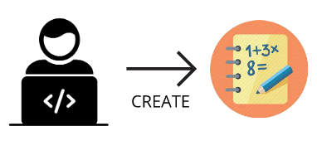
Idea & MVP
Interactive
13
Notes:
Then, where do those exercises come from? It’s simple. Independent programmers create them and add them in our platform and, if they want, they can promote the exercises, previously paying for it each two months.

Slide 14

Idea & MVP
Interactive
14
Notes:
That’s when the schools and academies come to scene. They buy those exercises from the programmer in order to increase the amount of exercises they have and offer their teachers a higher volume of content to use in their lessons.

Slide 15

Idea & MVP
Interactive
15
Notes:
In order to make these purchases, schools and academies can view a list with every single exercise that is in the system, choosing the ones they want to get and paying the price associated to the exercise.

Slide 16

Idea & MVP
Student & Teacher:
Interactive
16
Notes:
Once the school acquires the new exercises, teachers can use then to support their lessons, and students can access them in order to do them and use them as an addition to their learning. As another feature, teachers will be able to upload and download documents related to their subjects into the platform, and students can also access it.

Slide 17

Idea & MVP
Administrator:
17
Notes:
And last, but not least, the administrators of the system will be able to register new schools. These schools would be able to manage their teachers and students.

Slide 18
Let’s have a look
18
Notes:
To see which would be the main processes of the system, we’ve created an amount of mockups.

Slide 19
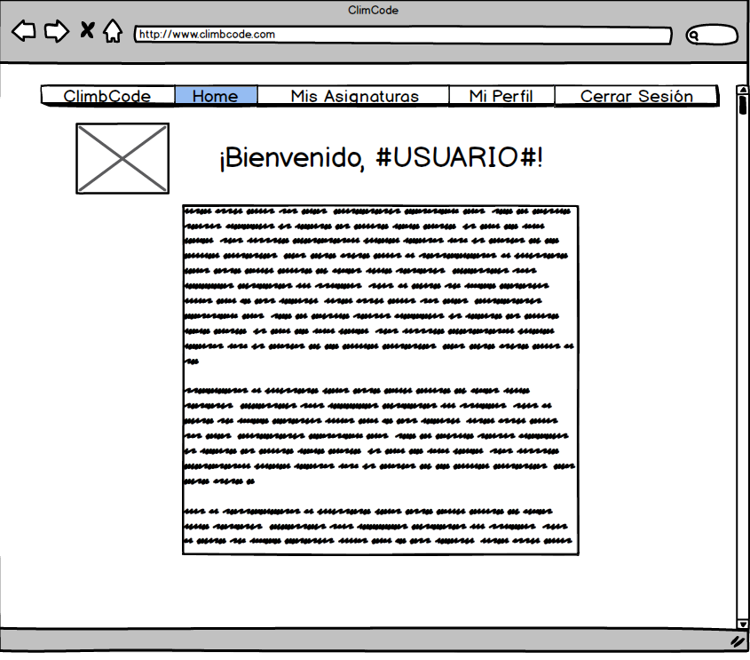
19
Notes:
In this one, we can see the view a student would have once he/she logs into the system. To do an exercise, the student just needs to access to the “Mis asignaturas/My subjects” view.

Slide 20
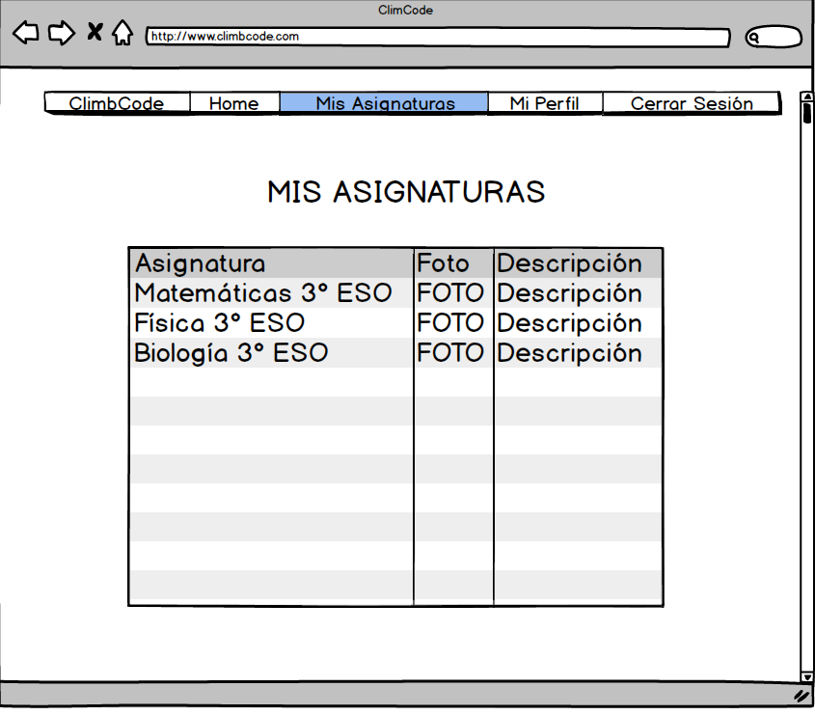
20
Notes:
Then, he/she would see the subjects he/she takes, and choose the one he/she wants to access by selecting its name.

Slide 21
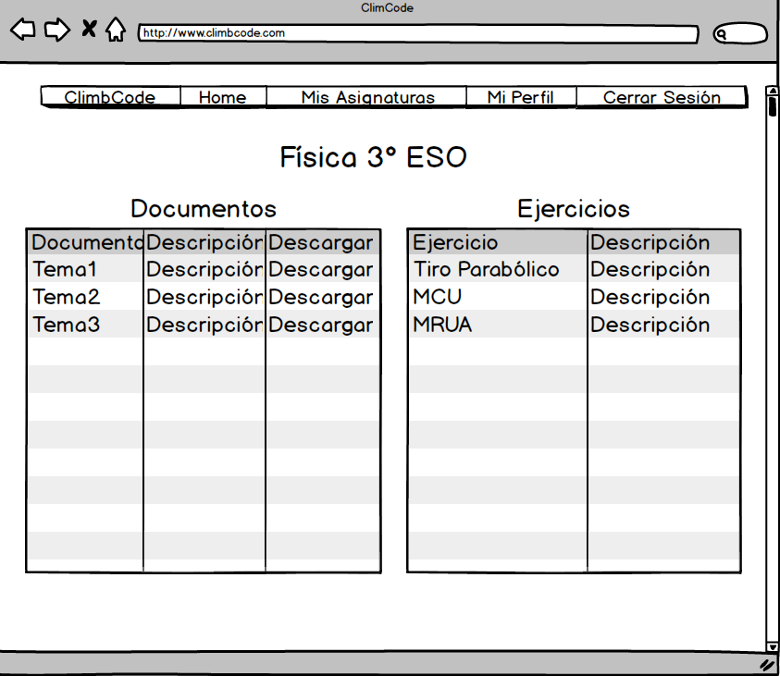
21
Notes:
That will lead the student to the content of the subject, which shows the documents he/she can download, and the exercises that the school has buyed for the subject. To do one, the student just needs to select its name.

Slide 22
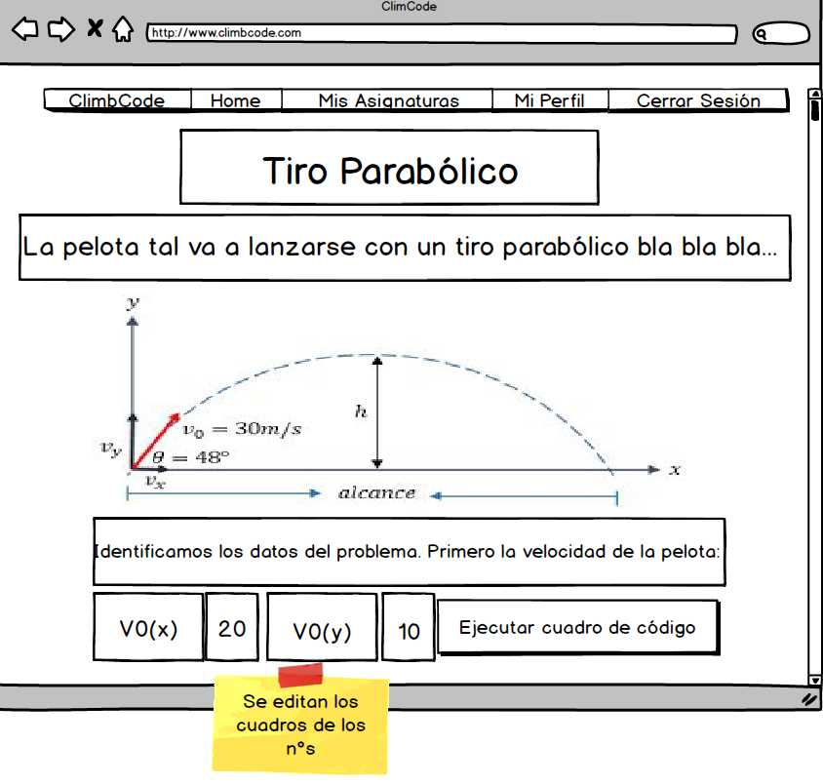
22
Notes:
That will show him/her the content of the exercises, which will have a title, an introduction to the exercise with the data needed in it, a graphic or picture if applicable, and explanations of how is it done, step by step. Then, the student could change some values in the exercise and watch how the result changes once executed again. In this example, those sections are the initial speed of the ball. After preparing the data, the student can see the result of his/her actions by selecting the execution button.

Slide 23
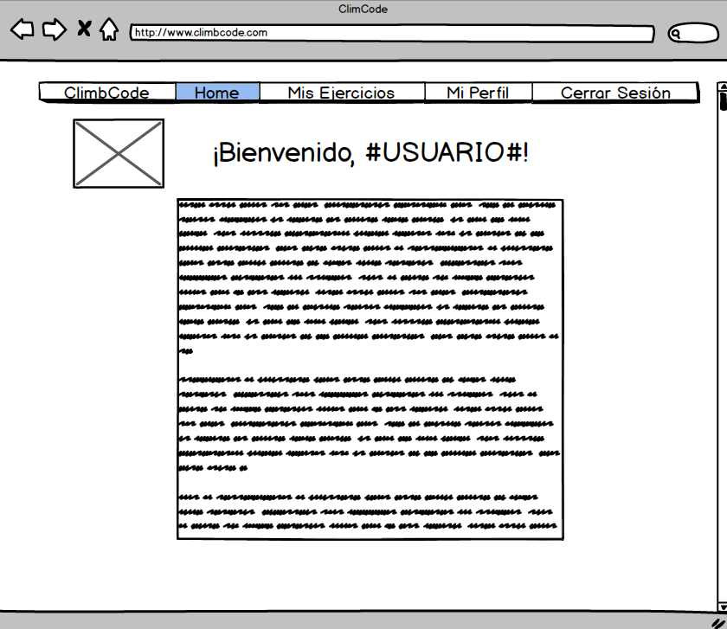
23
Notes:
The next mockup shows us what a programmer would see once he/she logs into the system. To create an exercise, he would access the “Mis Ejercicios/My Exercises” section.

Slide 24
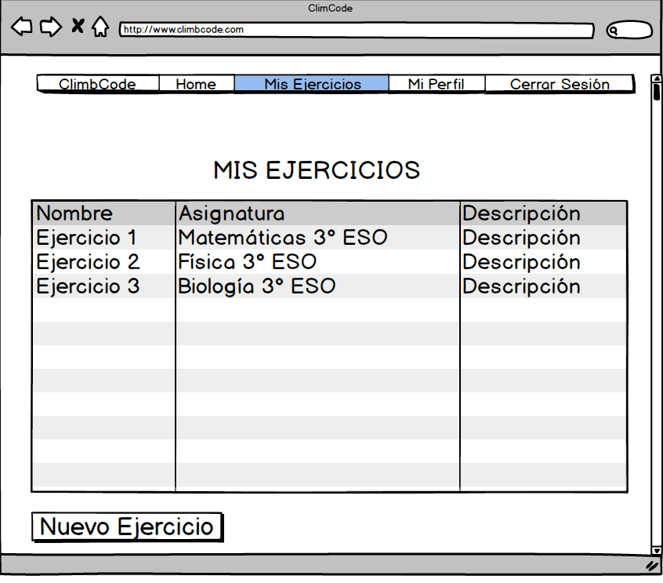
24
Notes:
Inside that view, we can see a list of all the exercises made by the programmer: The ones that are published in the system (and for sale) and the drafts, followed by some of their features. To create a new exercise, the programmer just has to select the “Nuevo Ejercicio/New Exercise” button.

Slide 25
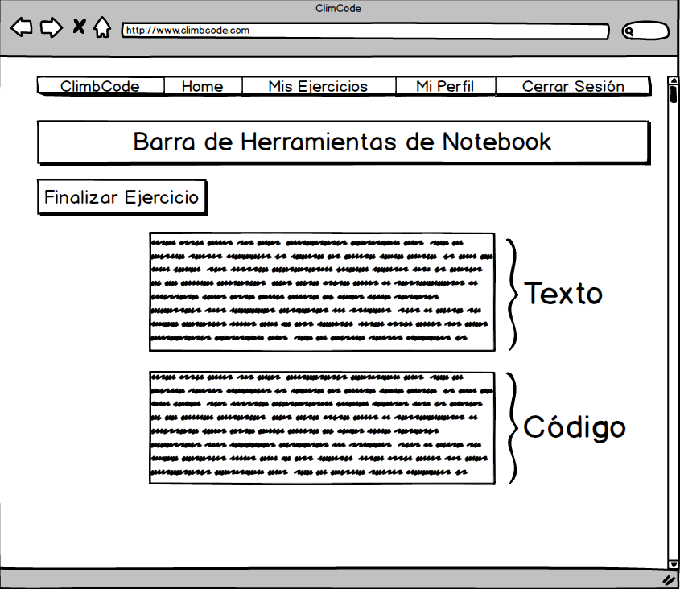
25
Notes:
That would lead him/her to a new view in which he/she can create his/her new exercise using the tools the platform has, allowing him to add text, code fields executable by the programmer to see the results of his/her work and fields for parameters: The interactive part of the exercise. Once the exercise is finished, the programmer can confirm its creation by the “Finalizar Ejercicio/Finish Exercise” button, which would publish it into the system or put it as a draft.

Slide 26




Idea & MVP
26
Notes:
Now that we’ve seen how the platform will work, the next thing that comes to out mind is if this idea isn’t already developed. To answer this, we’ve studied many of our competitors, and the result of it is always the same: They’re focused in academic management, document managment or teaching programming. That makes us a different choice, because we combine document management and supporting teachings with interactive exercises made thanks to programming, fulfilling our competitors’ features and adding a new one with those interactive exercises.

Slide 27
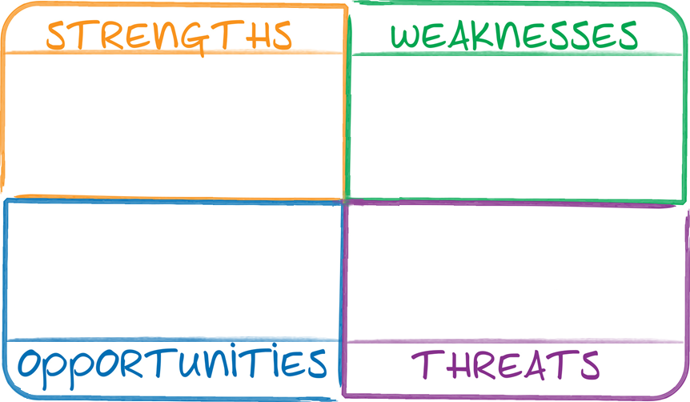


27
Notes:
Talking about our project’s strengths, we have that it is a different one, basing on the things we’ve said in the last picture, and that the platform is easy to use, because no programming knowledge is needed to do so while using the platform as a school, teacher or student.

Slide 28


28
Notes:
About or weaknesses, we find that it would be hard to expand to other markets, because our product is too focused on the educational sector. Also, if teachers have a too strict way to teach their lessons, it would be hard to introduce our product in their environment.

Slide 29
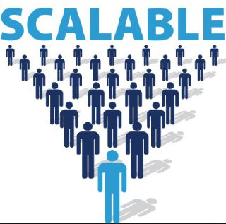
29
Notes:
Speaking about the opportunities, we have that it would be possible to jump to another platform different from the computers, for example tablets, which would increase the amount of clients we could get regarding the extension of the usage of tablets in teachers. The other opportunity is that it is also possible to add new features to our product, which would make us fulfill more of our client’s needs.

Slide 30

30
Notes:
And last, the theats that our project has to face are two: The fact that our competitors could take our idea and use it on their products, making competence harder for us, and the possibility that we can understimate the difficulty of developing some of our features, which could result into a delay in its development.

Slide 31
Business and Costs
Notes:
The next point we’re going to talk about is the business environment and the costs of our project.

Slide 32
Is it worth it?
32
Notes:
In order to know if the project would be accepted by our clients or not, we made a survey.

Slide 33
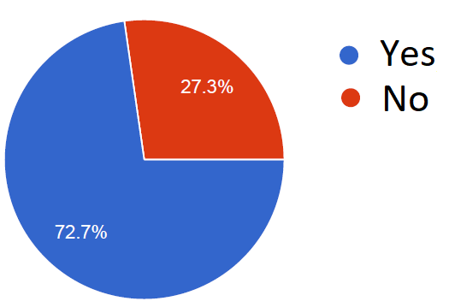
Business and Costs
From 88 people: Related to teaching
33
Notes:
In this survey participated 88 people, from which the 70% were related to teaching.

Slide 34
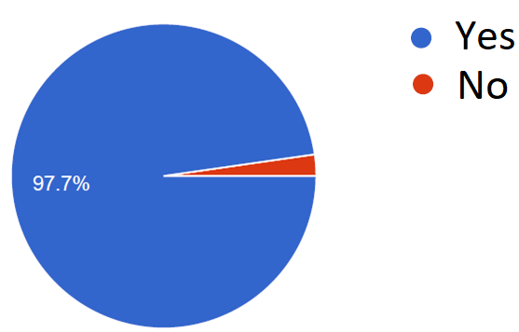
Business and Costs
From 88 people: Having a platform for supporting lessons.
34
Notes:
They were asked if they thought that it would be useful to have a tool for supporting teachers in their lessons. Almost everyone answered they thought so.

Slide 35
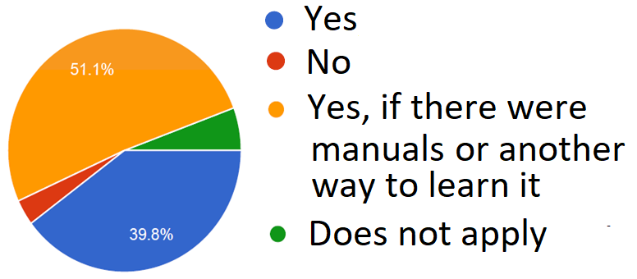
Business and Costs
From 88 people: Would use a tool for that
35
Notes:
Then they were asked that if they would use that tool at schools. Many of them answered again that they would use the tool, but in case that it was too complex, they would prefer doing so with the help of manuals or other helping tools. As we know, that wouldn’t be necessary at first, if we look at how our platform works.

Slide 36
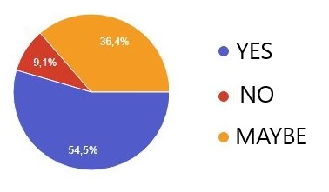
Business and Costs
From 47 people with programming knowledge: Would invest time in the platform
36
Notes:
Finally, we asked a group of 47 programmers if they would invest time in the platform and get some money as a result. Many of them agreeded.

Slide 37

How much?
37
Notes:
Once we’ve seen the acceptance of our product, the next doubt that we can have in mind is how much would that project cost in practice.

Slide 38
Business and Costs
Direct Costs: 16000 €
Indirect Costs: 4750 €
Marketing: 4150 €
38
Notes:
Then, we can see that, in the 4 months that the project would develop, we have an amount of 16000€ in direct costs, which refer to our team’s salaries.
In the case of the indirect costs, we would have 4750€ spent into co-working spaces, hosting of the application and amortizations.
Finally, about the marketing of the product, we would spent 4150€

Slide 39
Business and Costs
24900 € + 4150 € = 29050 €
39
Notes:
All those costs would make a total of 24900€. Adding the 4150€ saved for risks by the team, the project would cost a total of 29050€.

Slide 40
Business and Costs
0%
50%
100%
29050€
4688€
Current: 16%
Budgeted: 18%
40
Notes:
At the moment, we’ve spent the 16% of the money we’ve estimated (4688€), which puts us below the money expected to spent during these weeks.

Slide 41
Business and Costs
0%
50%
100%
1120 h
211 h
Current: 19%
Budgeted: 19%
41
Notes:
In terms of hours, we’ve spent the 19% of the time we’ve estimated (211h), which puts us with the exact time we thought we were going to spent during these weeks.

Slide 42
Business and Costs
0%
50%
100%
14525€
560 h
29050€
1120 h
Best: 50%
42
Expected: 100%
Notes:
In the best of the cases, we expect to spend half the amount budgeted both in terms of hours and money.

Slide 43
Business and Costs
0%
100%
200%
29050€
1120 h
58100€
2240h
Expected: 100%
43
Worst: 200%
Notes:
In the worst of the cases, on the other hand, we expect to spend twice the amount budgeted both in terms of hours and money.

Slide 44
Is it profitable?
44
Notes:
Seen that data, how do we get profit from the project and recover that investment?

Slide 45

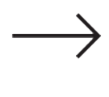
Business and Costs
Schools buy licenses
45
Notes:
The first way to do so would be selling licenses to schools. These licenses would be active for a year and would allow the schools and academies to make use of the full platform for an entire academic year, renewing it each one to keep the services. Also with the license, schools and academies would have access to an amount of starting exercises that can be increased by buying more exercises.

Slide 46
And tables to compare data
SIZE | USERS | FREE EXERCISES | PRICE
BASIC | 60 | 20 | 200€/y
MEDIUM | 200 | 50 | 550€/y
LARGE | 500 | 75 | 700€/y
46
Notes:
Then, we can order the different kinds of licenses we offer by the amount of users allowed to register and the number of starting exercises the client could access at first. That would lead us to these standard sizes of licenses, with their associated price. Also, in case of not finding a suitable size for him/her, the client can always contact us in order to negotiate a suitable size and price of license for both of us.

Slide 47
Business and Costs
Interactive
Schools buy exercises
47
Notes:
The second way we have for having a profit with these project is selling exercises. Interactive exercises have a buying price, which is payed for the schools and academies in order to increase the amount of exercises they have access to.

Slide 48

Business and Costs
%
ClimbCode
%
Programmer gets money
48
Notes:
From this price, a percentage goes to the programmer, acting as a motivation for possible content creators for the platform, and another percentage is kept for us.

Slide 49

Business and Costs
49
Notes:
As a clarification, all the previous transactions mentioned are made through PayPal, whose features will be integrated in our platform.

Slide 50
Work Methodology
Notes:
Finally, we’ll talk about the work methodology that we’re going to follow in this project.

Slide 51
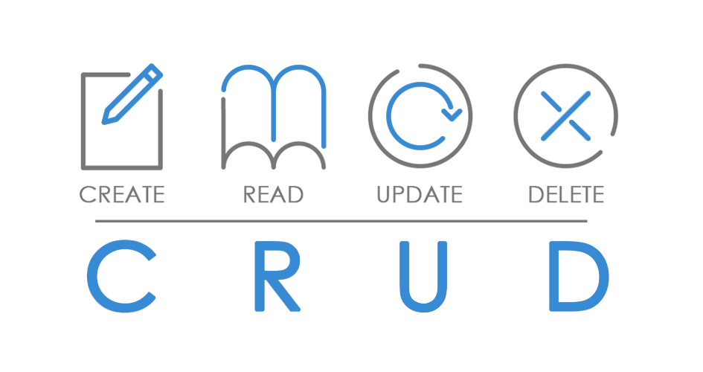
Work Methodology
Sprint 1:
Interactive
51
Notes:
As we know, we’ll use in the subject SCRUM as a methodology for developing the project, with 3 sprints to do so. The first one we will focus on developing the main CRUD of the system, with the first iteration over the interactive exercises’ system, whose objective in this sprint will be creating and doing exercises, but not saving them. As a result, we would have a basic platform in which we can create and manage schools and subjects as an administrator, create users (teachers and students) and select the exercises we want in our license as a school, create exercises as a programmer, do exercises as a student, and have a group of initial interactive exercises ready to persist.

Slide 52


Work Methodology
Future Sprints:
Interactive
52
Notes:
So, the next sprints would be focused on saving the interactive exercises, promoting them, doing the document management section, managing the transactions in the platform, fixing the feedback we get, and developing filters and searching ways for the interactive exercises’ list

Slide 53




Work Methodology
Development:
53
Notes:
About the technologies we’re going to use, related to development we will use Pyhton, Django and PostgreSQL for the main part of the product, and JavaScript for the interactive excercise management. The team isn’t an expert in these technologies, but has enough experience to face the development of the project with them.

Slide 54
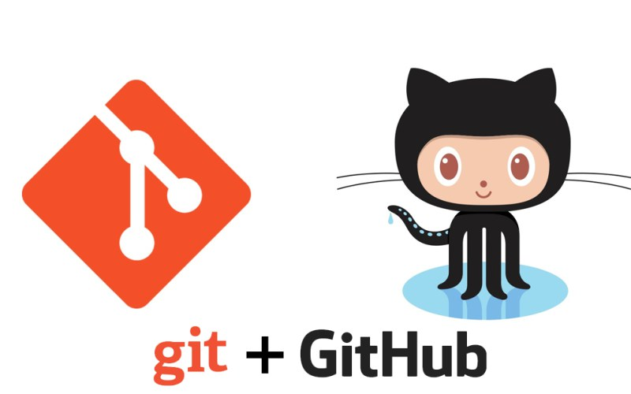
Work Methodology
Knowledge:
54
Notes:
Regarding the knowledge management, we will make use of a git repository hosted in github, where we can follow the development of the project and its tasks, adding the documentation and the knowledge generated if needed.

Slide 55

THANKS!
You can find me at
alvdomnun@alum.us.es
55
Notes:
And that’s the end of our presentation! Thank you for watching, and if you have any doubt you can contact me at alvdomnun@alum.us.es.

